Slide 1


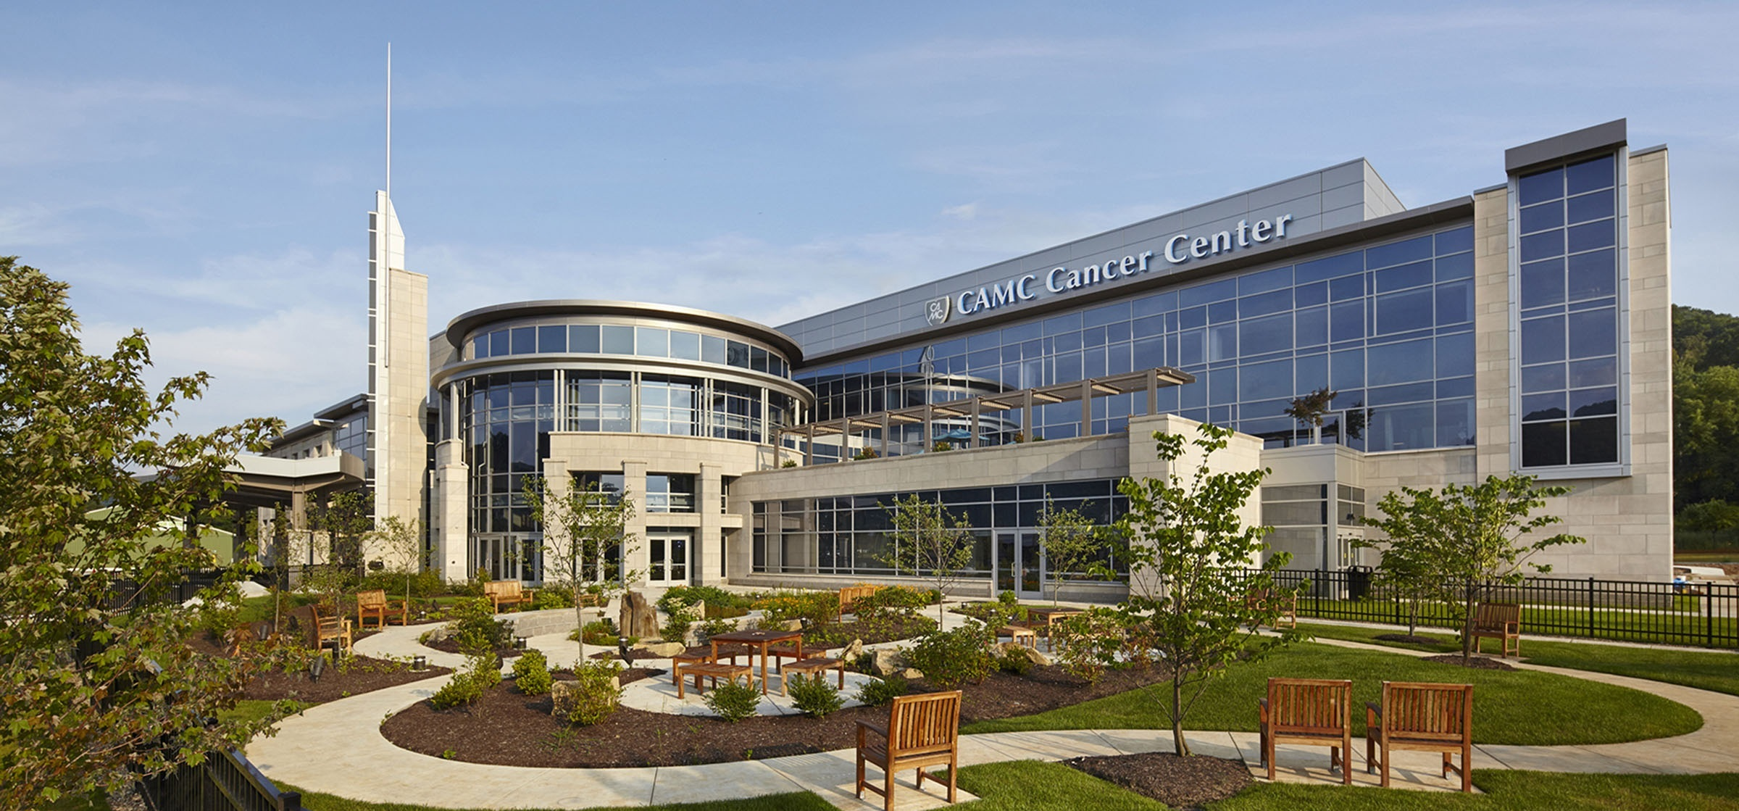
VANDALIA HEALTH DIRECT-TO-EMPLOYER PLAN
October 10, 2024

Slide 2



Founded in 1979 and headquartered in Indianapolis, IN​
Full-service TPA specializing in the administration of self-funded health plans and population health management​
One of the country’s largest independently-owned TPAs
The Key Family is a commonly-held group of benefits related organizations with:​
3,000+ corporate clients​
3.0 million members under management​
700 Employees
Exclusive Relationships
We know The Market – Agents, Networks, and MGAs

Slide 3


Market Leader in Private Labeled DTE Plans
Louisville, KY
OneHealth Plan
Cincinnati, OH
TCH Optimal
Bentonville, AR
Northwest Health Plan
Knoxville, TN
East Tennessee Health Plan
Meridian, MS
Affinity Health Plan
Fort Myers, FL
Lee Health Care Partners

Slide 4
Direct-to-Employer Strategy: Only Available to Premier Health Systems
STRONG Brand Quality
EXTENSIVE Patient Access
AFFORDABLE Value Pricing
EXCELLENT Care Quality

Slide 5
Vandalia Health is Patient Recommended
Based on quality measures and HCAHPS feedback, KBA estimates that Vandalia Health one of the strongest brands in West Virginia.
Health System | HCAHPS Recommendation Percentile | CMS Stars Percentile | Mortality Percentile | Readmission Percentile | KBA Brand Quality Score
WVU Medicine | 55 | 36 | 69 | 59 | 63
Vandalia Health | 47 | 55 | 62 | 66 | 61
ScionHealth | 16 | 31 | 67 | 74 | 49
LifePoint Health | 3 | 10 | 50 | 45 | 46

Slide 6
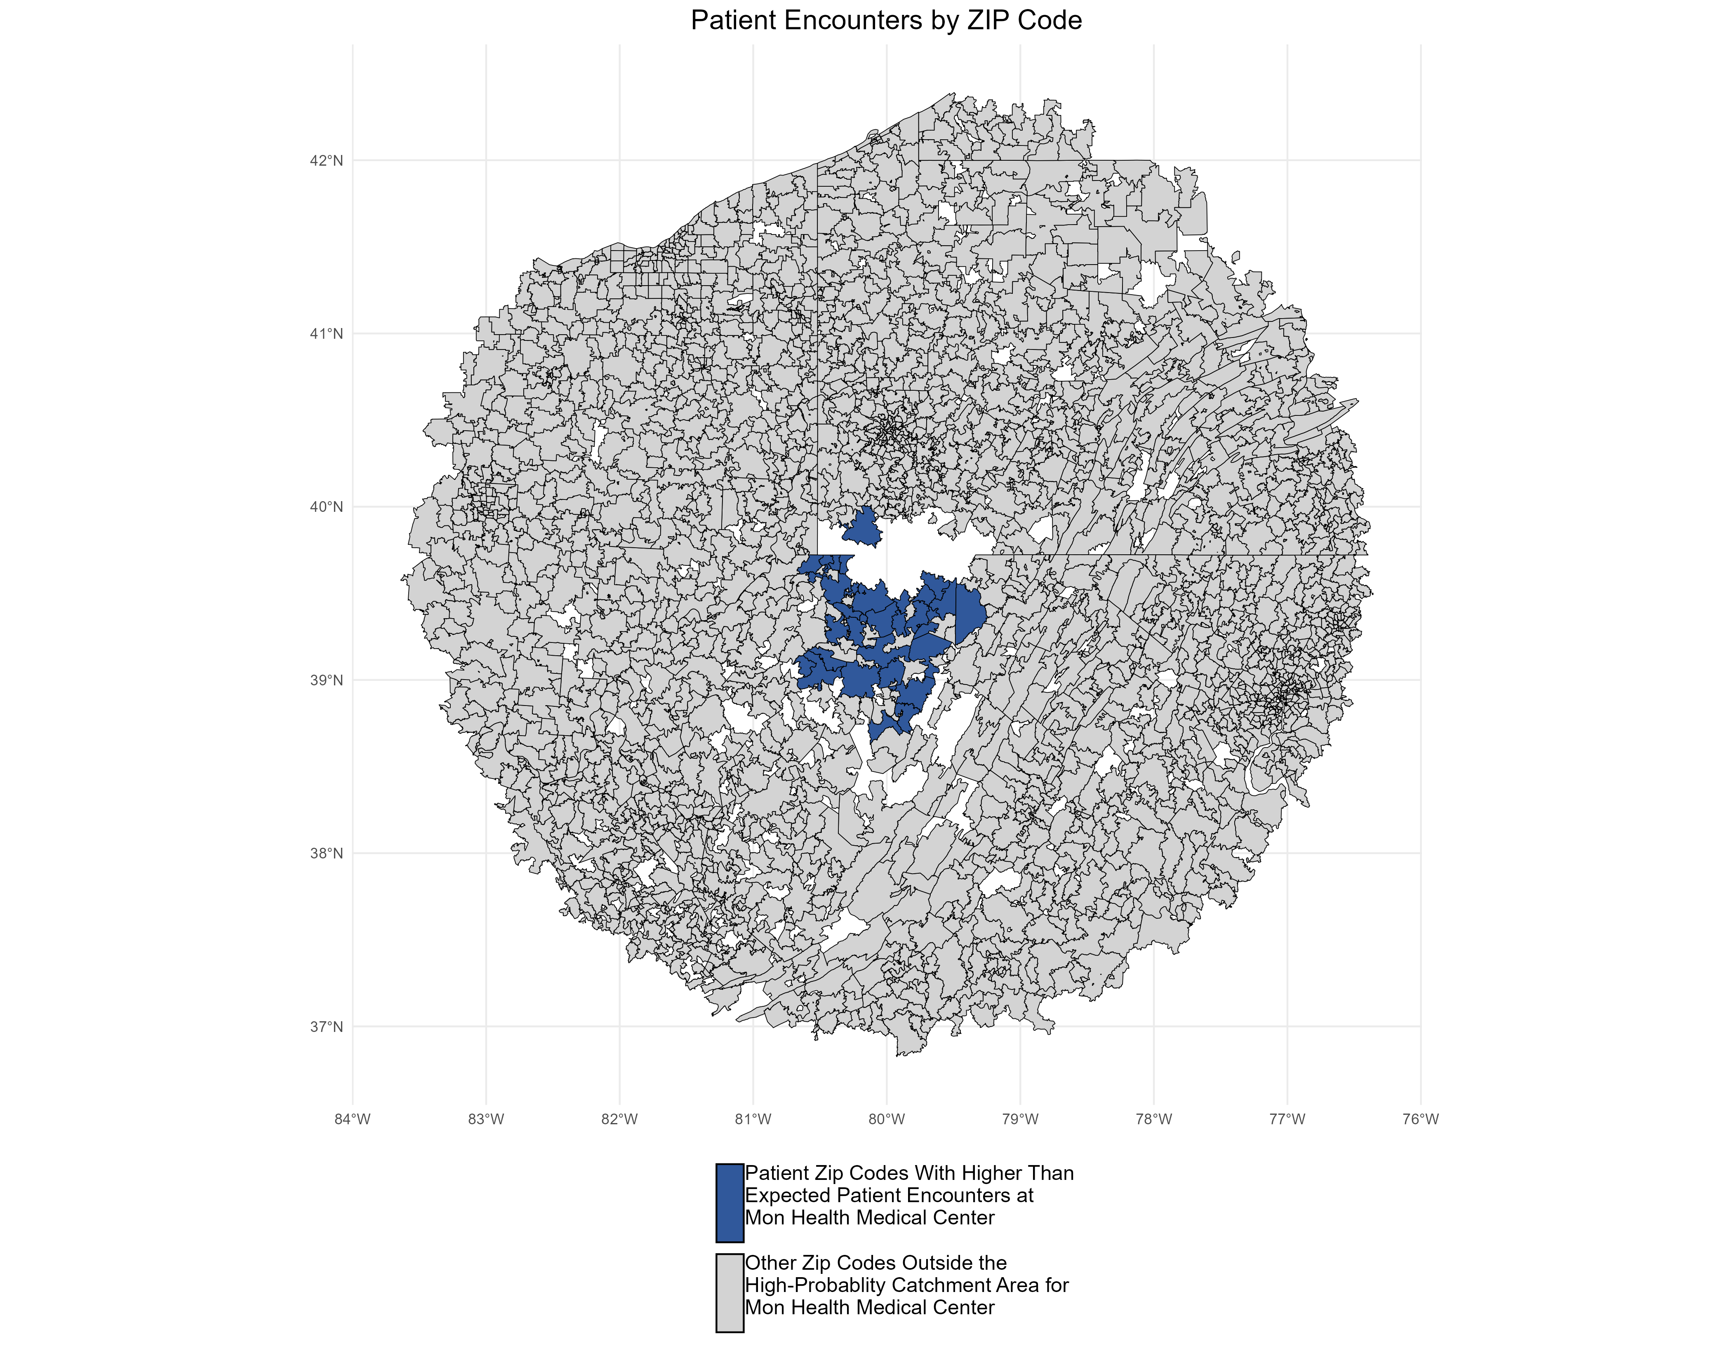
Patients Pass Other Hospitals to Come to Vandalia Health
KBA models Medicare patient encounter data to identify strong health system brands where patients will travel past other hospitals or long distances to frequent a specific hospital.
The center of the donut are zip codes within which patients have a higher probability of frequenting Mon Health Medical Center. These zip codes are ignored for this analysis.
Significant patient encounters outside of this center, as seen here, indicate that patients are willing to travel significant distances, passing other hospitals to go to Mon Health Medical Center.

Slide 7
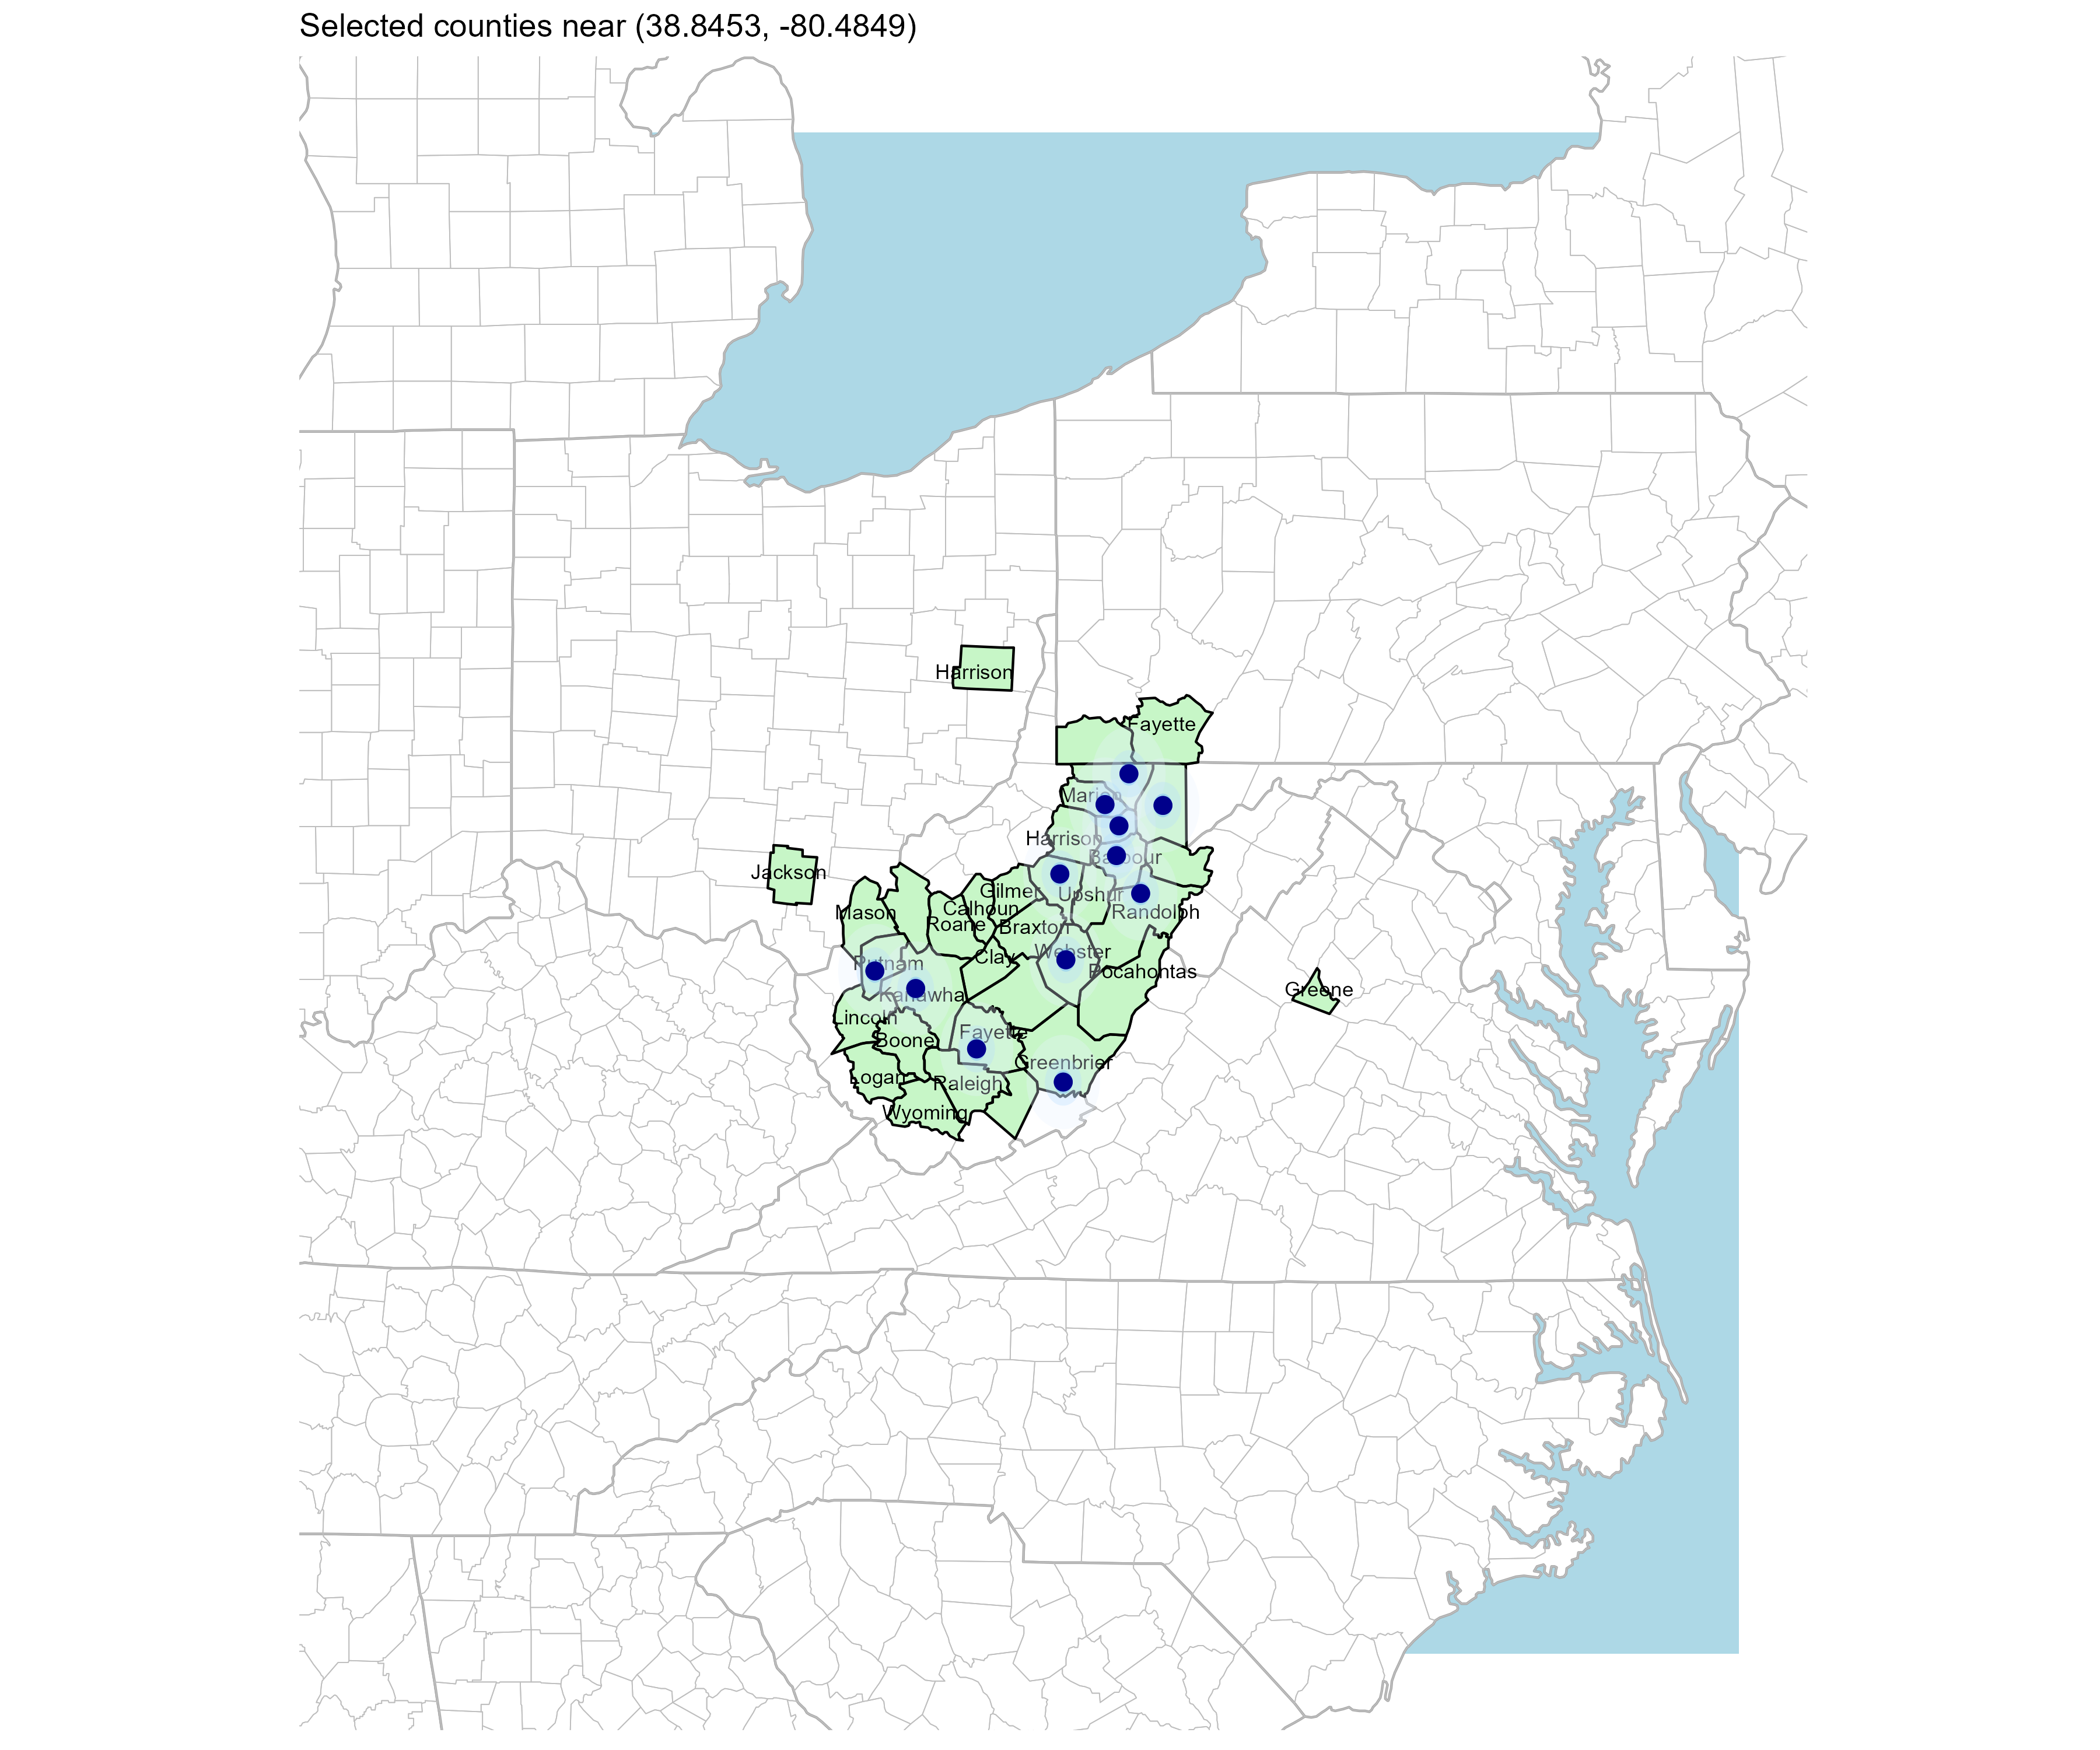
Significant Opportunity for Plan Growth
Target Market 900+ Employers 120,000+ Employees 190,000+ Members
 | Employer Size Group (# of Employees)
Commercial Employers With Headquarters | 50-100 | 101-200 | 201-400 | 401-1,000 | 1,001-3,000 | 3,000+
In Catchment Area | 464 | 209 | 129 | 54 | 24 | 11
Total Employees at Employers | 50-100 | 101-200 | 201-400 | 401-1,000 | 1,001-3,000 | 3,000+
Headquartered in Catchment Area | 34,800 | 31,350 | 38,700 | 37,800 | 48,000 | 121,000
Total Members with Employers | 50-100 | 101-200 | 201-400 | 401-1,000 | 1,001-3,000 | 3,000+
Headquartered in Catchment Area | 62,640 | 56,430 | 69,660 | 68,040 | 86,400 | 217,800
Researched for Clay, Lewis, Fayette, Jackson, Monroe, Greene, Boone, Braxton, Calhoun, Gilmer, Greenbrier, Kanawha, Lincoln, Logan, McDowell, Mason, Monongalia, Nicholas, Pocahontas, Preston, Putnam, Raleigh, Randolph, Roane, Summers, Taylor, Tucker, Webster, and Wyoming Counties

Slide 8
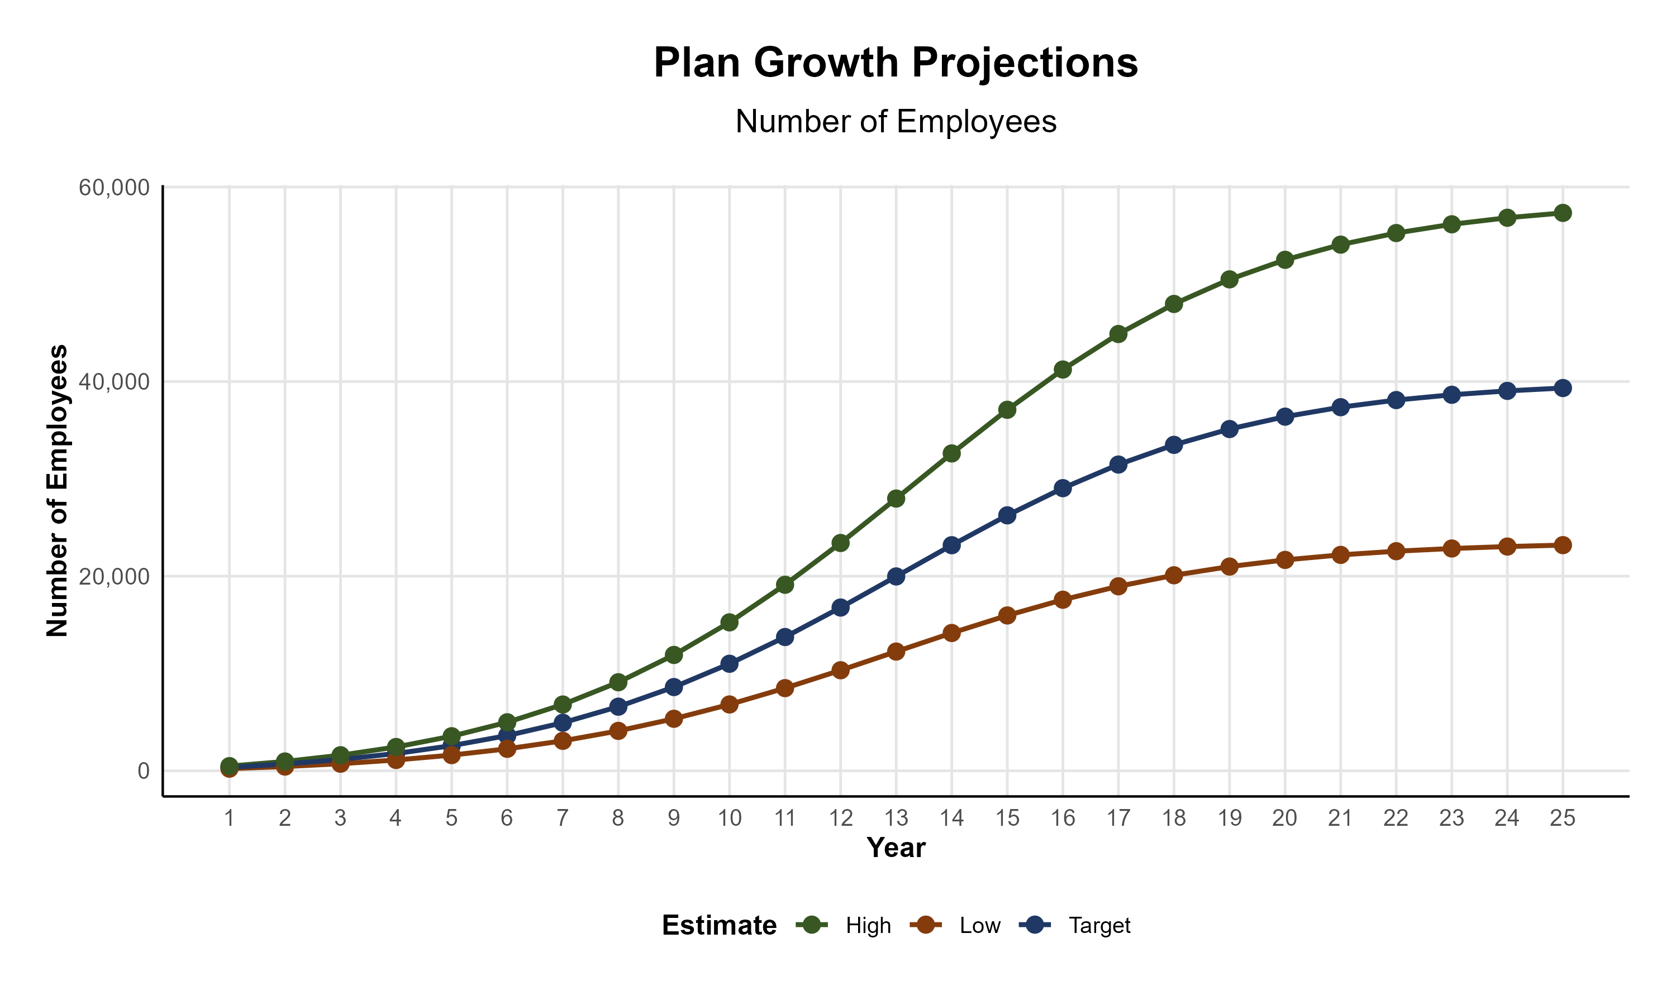
Plan Potential Growth Paths
Self Funded
261K
PLAN GROWTH POTENTIAL
441K
Insured
Working Age
745K
Population
1,318K
Estimates include Clay, Lewis, Fayette, Harrison, Jackson, Greene, Barbour, Boone, Braxton, Calhoun, Gilmer, Greenbrier, Kanawha, Lincoln, Logan, McDowell, Marion, Mason, Monongalia, Nicholas, Pocahontas, Preston, Putnam, Raleigh, Randolph, Roane, Summers, Taylor, Tucker, Upshur, Webster, and Wyoming Counties

Slide 9

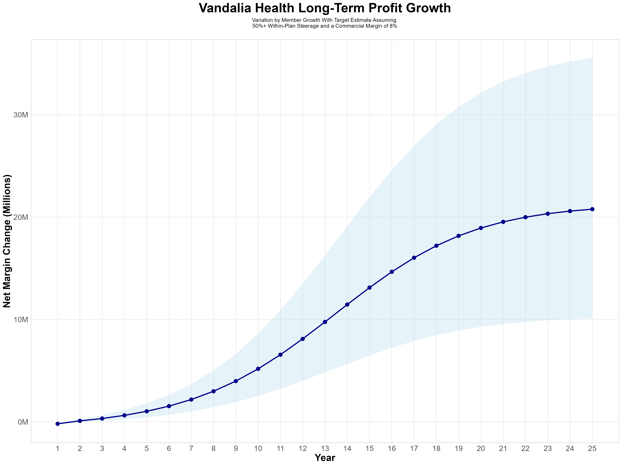
Growing Powerful, Lasting Profitability
Early Stage
Gaining Name Recognition, Early Growth
New Revenue:
New Profit:
$15.07M
$1.07M
Growth Stage
Strong Reputation, Strong Growth
New Revenue:
New Profit:
$110.41M
$9.1M
Mature Stage
High Profitability, Market Saturation
New Revenue:
New Profit:
$229.53M
$19.06M

Slide 10
Year 4 Projected Revenue and Profit
Pre-DTE Cohort of 3,600 Employees | Inpatient | Outpatient | Professional | Total
Revenue† | $ 1,407,375 | $ 1,822,031 | $ 850,873.1 | $ 4,080,279
Net Income‡ | $ 315,252 | $ 408,135 | $ 190,595.6 | $ 913,982.5
† Assuming proportional revenues from market shares of 13% (inpatient) and 9% (outpatient)
‡ Conservatively assuming a commercial margin of 22.4% (80% of the estimated commercial margin)
With DTE | Inpatient | Outpatient | Professional | Total
Revenue⁰ | $ 7,135,398 | $ 11,179,388 | $ 5,220,679 | $ 23,535,466
Net Income* | $ 1,598,329 | $ 2,504,183 | $ 1,169,432 | $ 5,271,944
⁰ Assuming 67% inpatient and 58% market steerage based on KBA narrow network DTE experience (see previous slide)
* Conservatively assuming a commercial margin of 22.4%, with a 10 percentage-point reduction to reflect competitive-edge rates and a 10 percentage-point increase due to lower billing costs and higher patient responsibility collections because of the member credit card.
Total Increase in Net Income | $ 4,357,962
Network Access Fee (Revenue) of $1 PMPM | $ 43,200
Total Profit Growth | $ 4,362,762
Minus Implementation Fee (One-Time) | -$ 0
Minus Sales and Marketing (Annual – Ongoing) | -$ 180,000
Total | $ 4,221,162

Slide 11
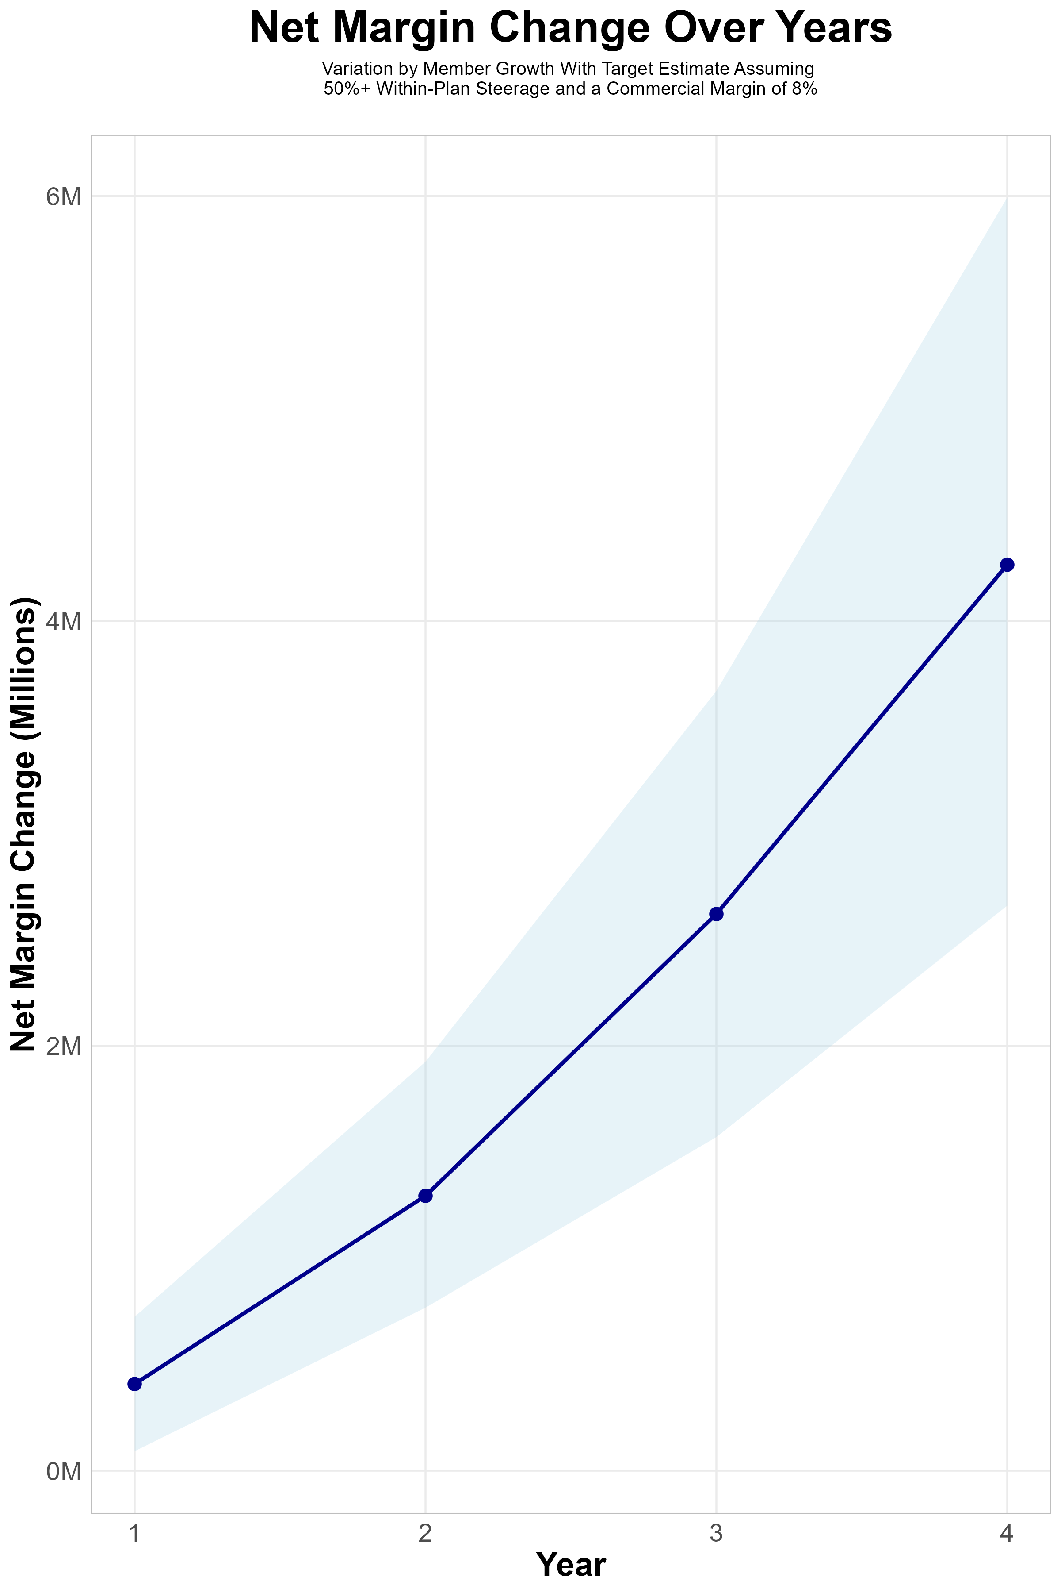
FOUR-YEAR PROJECTIONS
Target Member Growth | Target Member Growth | Target Member Growth | Target Member Growth | Target Member Growth
Metric | Year 1 | Year 2 | Year 3 | Year 4
Number of Members | 700 | 1,400 | 2,400 | 3,600
Incremental Margin | 729.5K | 1,456.7K | 2,771.3K | 4,401.2K
Network Access Fee | 8.4K | 16.8K | 28.8K | 43.2K
Implementation Fee (One-Time) | -150.0K | 0.0K | 0.0K | 0.0K
Sales and Marketing Costs | -180.0K | -180.0K | -180.0K | -180.0K
Net Margin Change | 407.9K | 1,293.5K | 2,620.1K | 4,264.4K
High Member Growth | High Member Growth | High Member Growth | High Member Growth | High Member Growth
Metric | Year 1 | Year 2 | Year 3 | Year 4
Number of Members | 1,000 | 2,000 | 3,300 | 5,000
Incremental Margin | 1,042.2K | 2,081.1K | 3,810.5K | 6,112.7K
Network Access Fee | 12.0K | 24.0K | 39.6K | 60.0K
Implementation Fee (One-Time) | -150.0K | 0.0K | 0.0K | 0.0K
Sales and Marketing Costs | -180.0K | -180.0K | -180.0K | -180.0K
Net Margin Change | 724.2K | 1,925.1K | 3,670.1K | 5,992.7K
Low Member Growth | Low Member Growth | Low Member Growth | Low Member Growth | Low Member Growth
Metric | Year 1 | Year 2 | Year 3 | Year 4
Number of Members | 400 | 900 | 1,500 | 2,300
Incremental Margin | 416.9K | 936.5K | 1,732.1K | 2,811.9K
Network Access Fee | 4.8K | 10.8K | 18.0K | 27.6K
Implementation Fee (One-Time) | -150.0K | 0.0K | 0.0K | 0.0K
Sales and Marketing Costs | -180.0K | -180.0K | -180.0K | -180.0K
Net Margin Change | 91.7K | 767.3K | 1,570.1K | 2,659.5K

Slide 12

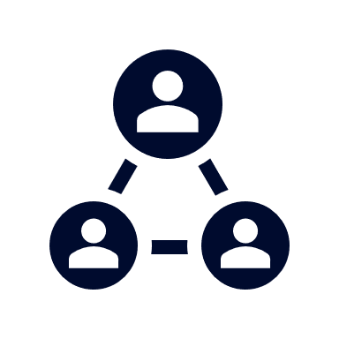



A Partner You Can Trust
OUR OBJECTIVES ARE ALIGNED
WE KNOW THE
MARKET
COMPLETELY TRANSPARENT
WE HAVE THE SOPHISTICATION AND INFRASTRUCTURE TO EFFECTIVELY COMPETE
Derek Moore, Senior Vice President – KBA
845-283-9973 * derek.moore@keybenefit.com

